Slide 1

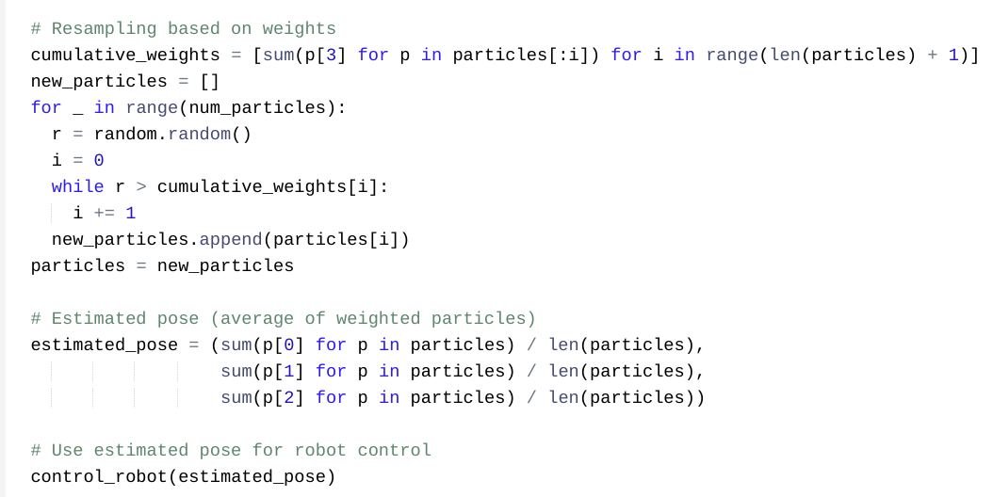
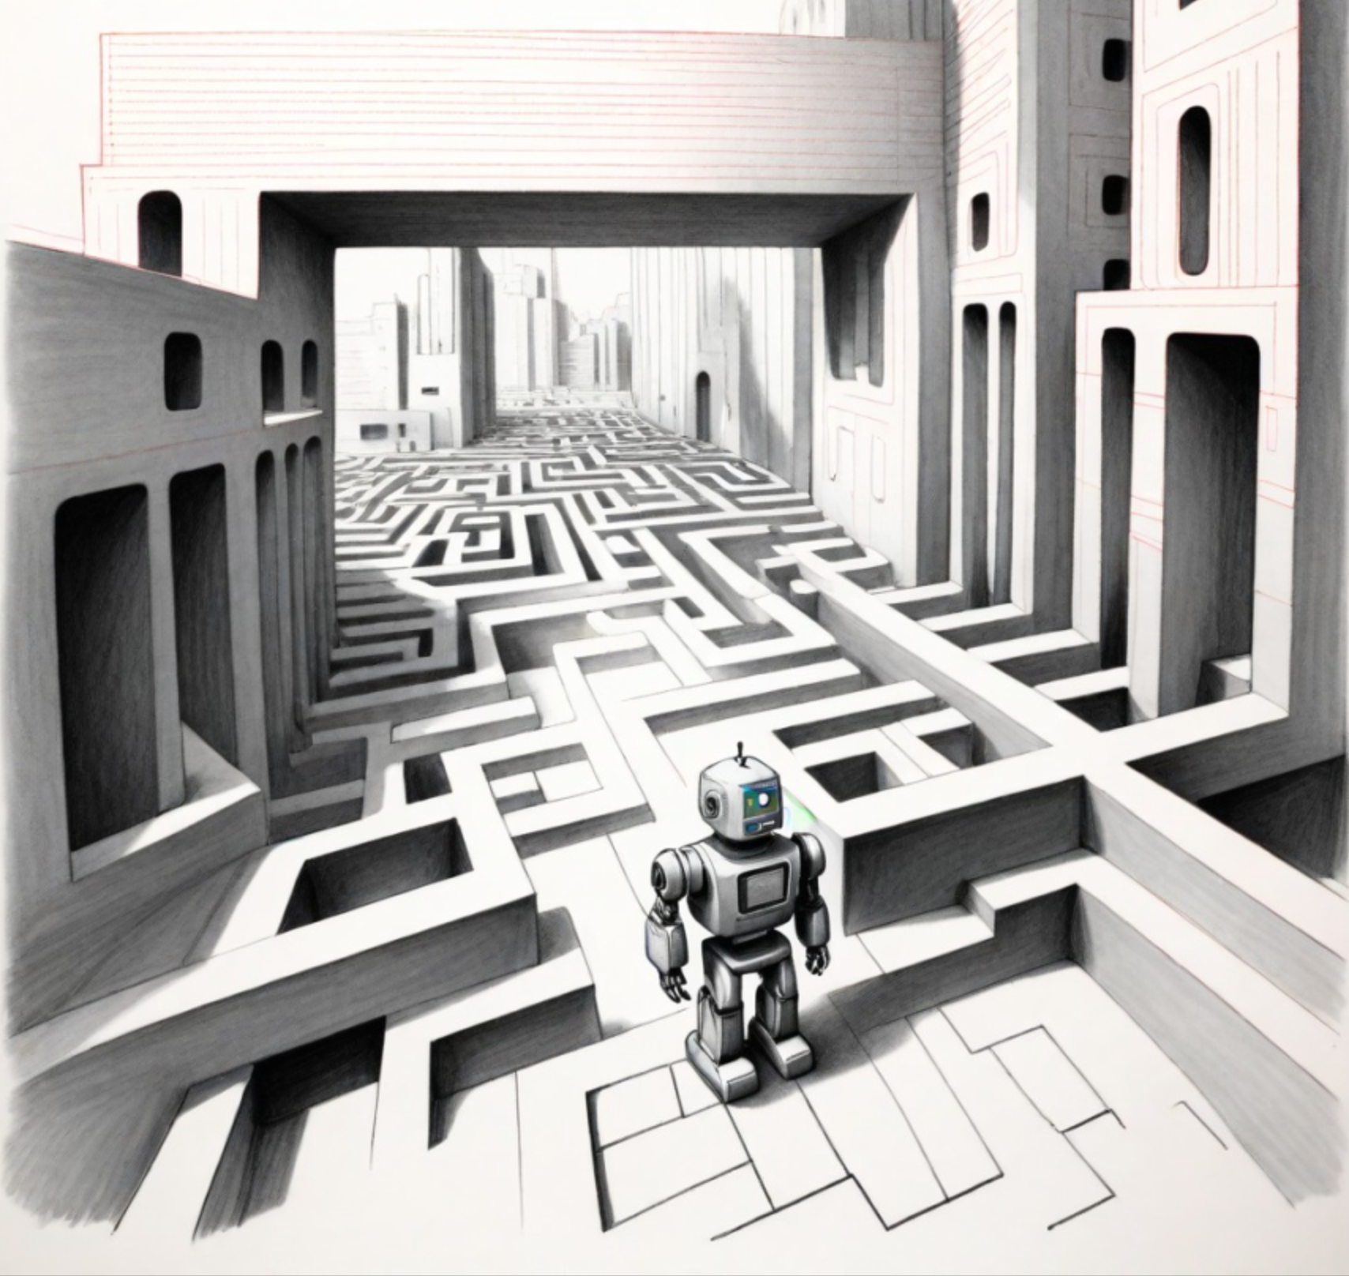
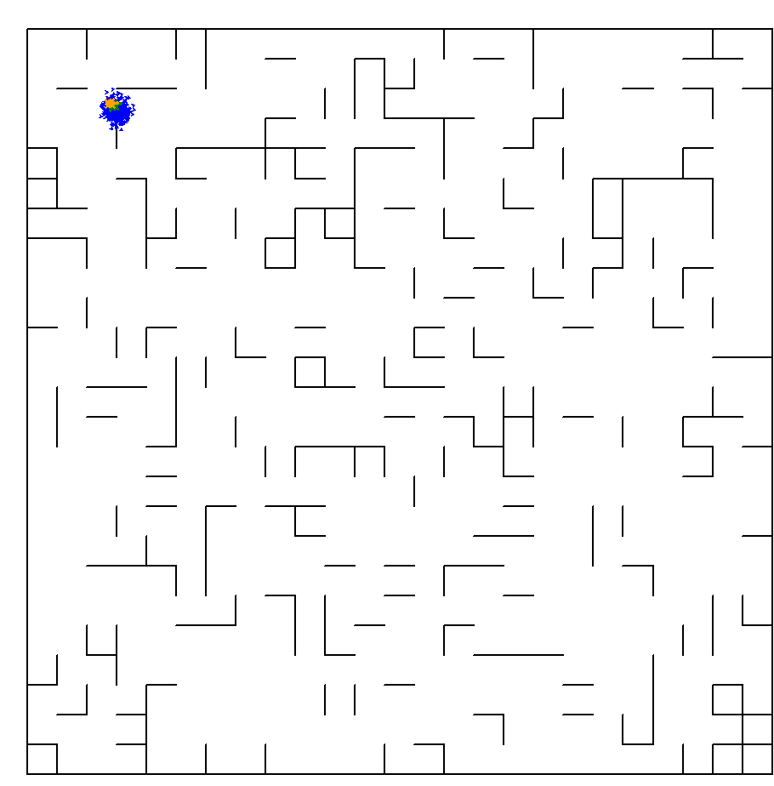
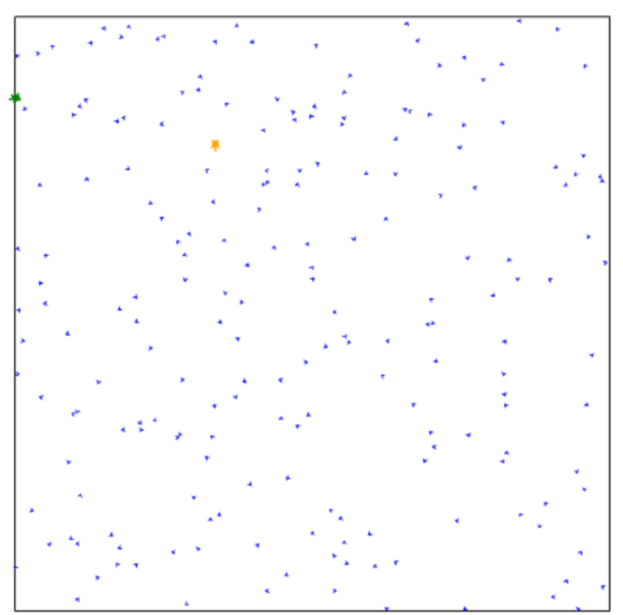
Monte Carlo Localization: A Probabilistic Approach to Robot Navigation
A Bhumika Rao || Ashutosh Kumar || Swetika || Navneet Kumar Chaubey
International Institute of Information Technology , Naya Raipur
INTRODUCTION
CODE
CONCLUSIONS
Robot localization is the process of determining where a mobile robot is located with respect to its environment. Localization is one of the most fundamental competencies required by an autonomous robot as the knowledge of the robot's own location is an essential precursor to making decisions about future actions.
Monte Carlo Localization ( MCL)
Monte Carlo Localization (MCL) embraces the power of probability. It represents the robot's possible locations using a cloud of particles, each with a weight reflecting its likelihood of being the robot's true position.
This "cloud" of possibilities is formed by tiny virtual particles, like a swarm of bees exploring a field. Each particle represents a potential location for the robot in the environment.
As the robot moves and gathers sensor data (like wall proximity), MCL isn't static. It cleverly uses this data to adjust the positions and weights of the particles. Particles that align well with sensor readings become more likely to be the robot's location, while others lose weight.
Over time, MCL builds a more refined picture of where the robot truly is by constantly updating this "particle swarm.".
MCL thrives in environments with noisy sensors and imprecise robot movement. Unlike techniques that require highly accurate data, MCL embraces the probabilistic nature of robot localization, making it adaptable to real-world scenarios.
MCL isn't limited to simple environments. It can handle complex robot models and non-Gaussian sensor noise, making it suitable for various applications like navigating cluttered rooms or outdoor terrains
Advantages :
1.Handles Uncertainty: MCL excels in environments with noisy sensors and imprecise robot movement. It thrives on probabilities, making it adaptable to real-world scenarios.
2.Adaptable to Complexity: Unlike some techniques, MCL can handle complex robot models and non-Gaussian sensor noise. This makes it suitable for navigating cluttered rooms, outdoor terrains, and various applications.
3.Continuous Improvement: MCL is a dynamic approach. As the robot gathers more sensor data, its estimate of the location constantly refines. This allows the robot to navigate with increasing accuracy.
4.Computationally Scalable: While involving a large number of particles, optimization techniques make MCL suitable for robots with varying processing power.
Disadvantages:
1.Computational Cost: Although scalable, processing a large number of particles can be computationally expensive for resource-constrained robots.
2.Degenerate Particle Sets: In some situations, all particles might have very low weights, making localization difficult. Careful design and parameter tuning can help mitigate this
.
3.Initial Distribution Dependence: MCL's performance can be sensitive to the initial distribution of particles. Strategies exist to improve this, but it's a factor to consider.
Overall, Monte Carlo Localization with particle filters is a powerful and versatile tool for robot navigation in uncertain environments. By understanding its advantages and potential limitations, we can effectively utilize MCL to guide robots towards their goals with greater accuracy and robustness.
RESULTS
The robot successfully navigated complex mazes utilizing Monte Carlo Localization (MCL) for position estimation. In each environment (Figures 1 and 2), particles were initially dispersed throughout the maze, representing the robot's possible locations with equal probability. As the robot traversed the maze and collected sensor data (e.g., wall detections), MCL continuously updated the particle distribution. Particles that aligned with sensor readings increased in weight, while those in improbable locations decreased in weight, effectively refining the robot's understanding of its position within the maze. This process of refinement led the particles to converge around the robot's true location, enabling successful navigation in both environments.
METHODOLOGY
Particle Initialization: The algorithm initializes a set of particles, each representing a potential location and orientation (pose) for the robot within the environment. These particles are assigned equal weights, signifying an initial uniform probability for each particle to be the true robot location.
Iterative Refinement:
Motion Update: In each iteration, the poses of all particles are updated based on estimated robot movement data (odometry). However, to account for uncertainties in movement, noise is incorporated into the update process.
Sensor Weight Update: Following the motion update, particle weights are adjusted based on a sensor model function. This function assesses how well a particle's predicted location (based on its pose) aligns with the data obtained from the robot's sensors and the map information. Particles that demonstrate better alignment receive higher weights, indicating a greater likelihood of representing the true robot pose.
Estimated Pose Calculation: Finally, the algorithm calculates the estimated robot pose . This is achieved by computing the average position and orientation of all weighted particles. This estimated pose reflects the most likely location of the robot based on the current particle distribution and their associated weights.
REFERENCES
Some of the code in this project were revised from the Beacon Based Particle Filter project. But the robot environment is totally different and the sensor measure mechanism is also totally different.
Source:Beacon Based Particle Filter(https://github.com/mjl/particle_filter_demo).
ACKNOWLEDGEMENTS
Figure 1 Maze World
Figure 2 Blank World , no obstacles , turtle bot and initial particle distribution
Guided by- Dr. Shailesh Khapre
Notes:
‹#›

Slide 2
CODE REFERENCE LINK
https://github.com/leimao/Particle-Filter
LINK TO OUR PROJECT (BLANK/EMPTY ENVIRONMENT)
https://drive.google.com/drive/folders/1y5rART0kxuwiYi4emyDrglhB9EqPV70e?usp=drive_link
MAZE ENVIRONMENT

